Slide 1

Utilizing evidence based practices to reduce client risk

Slide 2

Objective
*Introduce the Risk Need Responsivity (RNR) Model and principles of effective interventions.

Slide 3

How AFFECTIVE HAS Community Supervision Been?
What are the goals of community supervision?
How are we doing in accomplishing those goals?

Slide 4

Community supervision
The Bureau of Justice Statistics tracked recidivism for 404,000 prisoners released from state prison (30 states) in 2005 for three and five year periods. It was determined 67.8% of prisoners were arrested for a new crime within three years and 76.6% were arrested within five years.
Alexia D. Cooper, Ph.D., Matthew R. Durose, Howard N. Snyder, Ph.D.

Slide 5
Community Supervision
A review of 15 studies that compared some form of community supervision with an alternative criminal sanction (e.g., prison sentence, fine), found recidivism was only two percentage points lower on average for offenders under community supervision. There was no decrease in violent recidivism associated with community supervision.
James Bonta, et al. (2008)

Slide 6


Slide 7

What Works?

Slide 8
The RNR Model
Risk Principle
Need Principle
Responsivity Principle
“The RNR model “seeks an understanding that offers the potential not only to forecast criminal events but to influence the chances of criminal acts occurring through deliberate intervention.” (Andrews & Bonta 2010)
*Up to 35% reductions in recidivism when implemented in certain settings (Bonta & Andrews, 2007)

Slide 9
Risk Principle
Allocate time and resources to higher risk offenders, as their exposure to appropriate interventions and services actively reduces risk.
Conversely, the impact services and interventions have on low risk offenders is generally insignificant and potentially aggravates risk.

Slide 10

Needs principle: Targeting what matters

Slide 11
Needs Principle
Interventions are most effective when they target criminogenic needs (changeable).
  1.Cognitions
  2.Social Networks
  3.Personality
4.Family/Marital factors
5.Education/Employment
6.Leisure/Recreation
7.Substance abuse

Slide 12

Responsivity principle: Creating An environment conducive to positive change

Slide 13
Responsivity Principle
General: Cognitive behavioral and other structured skill building
Specific: Stage of change (i.e., Pre-contemplation, Contemplation, Preparation, Action, Maintenance), gender, age mental health, cognitive skill level, cultural considerations etc…

Slide 14
Post Conviction Risk Assessment (PCRA)
Designed to identify dynamic risk factors pertaining to each individual (e.g., Education and Employment, Substance Abuse, Social Networks, Cognitions)
Contains an 80-item self-report questionnaire that assesses criminal thinking
Scoring results in individuals being placed in one of four risk categories: High, Moderate, Low/Moderate, Low
Research indicates the tool is a reliable and valid assessment of risk

Slide 15
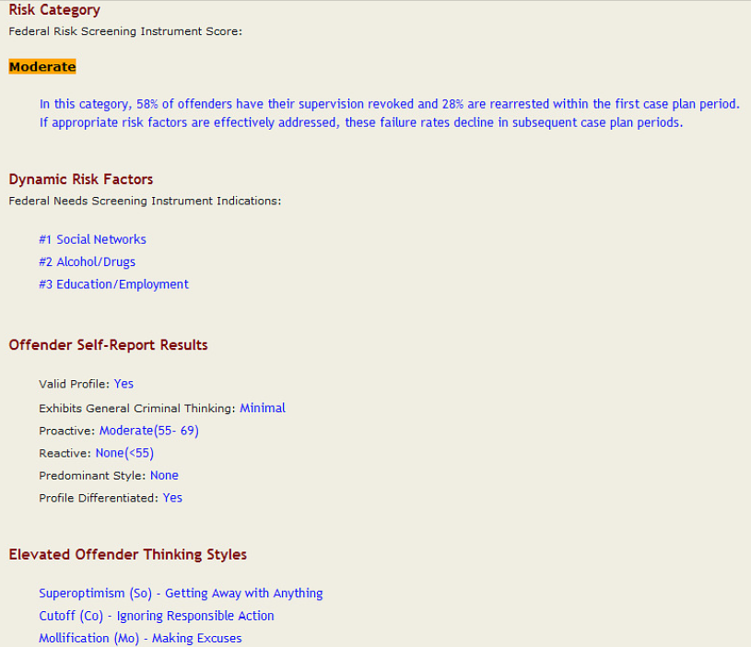
Notes:
What does this mean?
How do you use this information?
What does your case plan look like based on this information?

Slide 16
Monthly Treatment Reports
Here is what we are looking for:
  Treatment focus should be rooted in DRFs (i.e., cognitions, social net, alcohol/drugs, edu/employ)
  MTR should provide details about progress in criminogenic areas.
  Treatment plan should account for client risk. Not a “one size fits all” approach.
  Avoid “canned language” and provide information specific to client’s treatment status.
  Evidence of escalated threat of violence should be staffed immediately with assigned USPO.

