Slide 1

U.S. Probation & Pretrial Services Treatment Services Providers Training
10.26.2021

Slide 2
Welcome/Introductions
Jeffrey Thomason- Chief US Probation & Pretrial Services Officer
Cindy Martinez- SD Drug Lab Supervisor
Roger Robinson- Program Development Specialist, AO
Richard Hwang- Supervisor and Treatment Services Coordinator
Christina Le- Special Offender Specialist
Objectives:
Discuss AO Review findings
Highlight common monitoring recommendations
Provide reminders about proper documentation
Discuss next steps/telemedicine
Notes:
Last summer our headquarters (the Administrative Office of the US Courts), conducted a thorough Review of our agency, including cases with Treatment.
Vendor monitoring reports were part of this Review.
Monitoring visits will start in November and continue through January.

Slide 3
Chief US Probation & Pretrial Services Officer Jeffrey Thomason

Slide 4
SD Pretrial Drug Lab Supervisor Cindy Martinez

Slide 5
Program Development Specialist/EBP Coordinator Roger Robinson

Slide 6
AO Review Findings
Officers and Vendors need to communicate MONTHLY for cases with counseling (substance use and MH)
Discuss progression/regression in treatment and document this interaction in progress notes and/or MTR’s
Files did not contain comprehensive Treatment Plans and in many instances, quarterly updates were not being done (for cases with counseling)
Discharge summaries were not completed in a timely manner
These items are not required for cases referred for drug testing only
Suggestion: counselors and Officers can establish a set appointment every month to discuss cases
Notes:
Treatment plans were found in files, but not containing all the required information.

Slide 7
AO Review Findings
Treatment Plans
Required for cases with counseling
Should be completed at the commencement of treatment within 30 days and updated at least quarterly with defendants/offenders (D/O’s)
Please remember to email these, along with the Monthly Treatment Reports to Carina Forsythe at: carina_forsythe@cacp.uscourts.gov
who will then forward them to assigned PO
Notes:
Show examples of treatment plan on internet site

Slide 8
AO Review Findings
Ensure that treatment plans are present in files and include:
(a) short and long term goals for the D/O’s;
(b) measurable objectives;
(c)type and frequency of services to be received;
(d) specific criteria for treatment completion and the anticipated time-frame;
(e) documentation of treatment plan review (including D/O’s input;
(f) and, continued need for treatment, if necessary
The plan should include information on family and significant others’ involvement (i.e., community support programs, etc.)

Slide 9
AO Review Findings
Discharge Summary- Outpatient
Ensure that a typed discharge summary is submitted to the USPO/USPSO within 15 calendar days after treatment is terminated. The summary shall outline the reason for concluding contract services, (i.e., the D/O responded to treatment and treatment is no longer needed, or the D/O failed to respond to treatment)
Additionally, the discharge summary shall include recommendations for community-based aftercare that the D/O can readily access
In all cases, the discharge status (i.e., successful discharge, unsuccessful discharge, interruption of treatment, etc.) shall be clearly stated
Notes:
Community based includes 12-step/self help groups, county Medi-Cal resources, etc.
Discharge Summary forms can be generated by the vendor.

Slide 10
AO Review Findings
Discharge Summary- Residential
Successful Discharges
Summary should describe the D/O’s adjustment and performance while in treatment and the circumstances surrounding D/O’s termination. A typed summary to the USPO/USPSO within 10 calendar days of the D/O’s discharge that includes recommendations for aftercare treatment
Unsuccessful Discharges
Discharges due to D/O’s misbehavior are to be approved by the officer, unless there is a positive lab drug test or an immediate discharge is necessary due to safety issues of other residents. In emergency cases, where pre-approval is not possible, the officer is to be notified within 12 hours of the discharge. A discharge summary must be submitted to the USPO/USPSO within 5 days.
Notes:
Positive drug test with results from the lab, not vendor onsite test.
Examples of immediate discharge is a violent outburst, threatening staff, or possession of drugs.

Slide 11
Monitoring
Programs will be reviewed at least two times the first and second years of the BPA
If unsatisfactory rating, vendor will have a follow- up review
Deficiencies can result in a Cure Notice that requires a formal response
Vendor will be held to the standards in the proposals submitted
Review SOW’s, including Local Needs with all staff (found in Section C of the RFP)
Notes:
We will begin the first round of reviews, which go from Nov to Jan

Slide 12
Required File Documents
Program Plan (initial, amended, terminations)
Authorization to Rel. Confidential Information
Monthly Treatment Reports
Treatment Plans-initial and quarterly updates
Chain of Custody forms
Daily Treatment Log (outpatient)
Chronological notes that include monthly Officer contact and counseling notes
Reports and Evaluations (if applicable)
Discharge Summaries (if applicable)

Slide 13
Referral Process
USPO/USPSO calls or emails to schedule initial intake appointment for D/O
USPO/USPSO forwards:
Program Plan
Aftercare Case Summary/Bail Report
Vendor shall:
Execute Release of Information form if Officer is unable
The vendor shall obtain the D/O’s signature before releasing any information regarding the D/O or their treatment in progress to the Officer
Please make sure to completely fill out all the blank items, including name and address of the program
Form can be found on our internet site
Notes:
If paperwork is sent to a Headquarter location the paperwork must be distributed to the actual intake site prior to the appointment.
Ensure Release form is filled out completely, Offender/defendant signs, and Witness signs and is in the file. Needed for shared communication between officer and provider. If not fully executed for a Court action, case can be entirely thrown out.

Slide 14
Referrals for MH Treatment
Assessments will be requested and must be completed within 15 days
Your recommendations for services will be sent to and discussed with the Officers who will amend the program plans accordingly
One long-term goal is to get D/O referred to county, VA, Medi-Cal or other services for long-term assistance beyond supervision
Notes:
Officers and clinicians need to work together to determine the correct services needed by each individual
Especially medications, we need to ensure D/Os are not dependent on our services, but able to transition off supervision

Slide 15
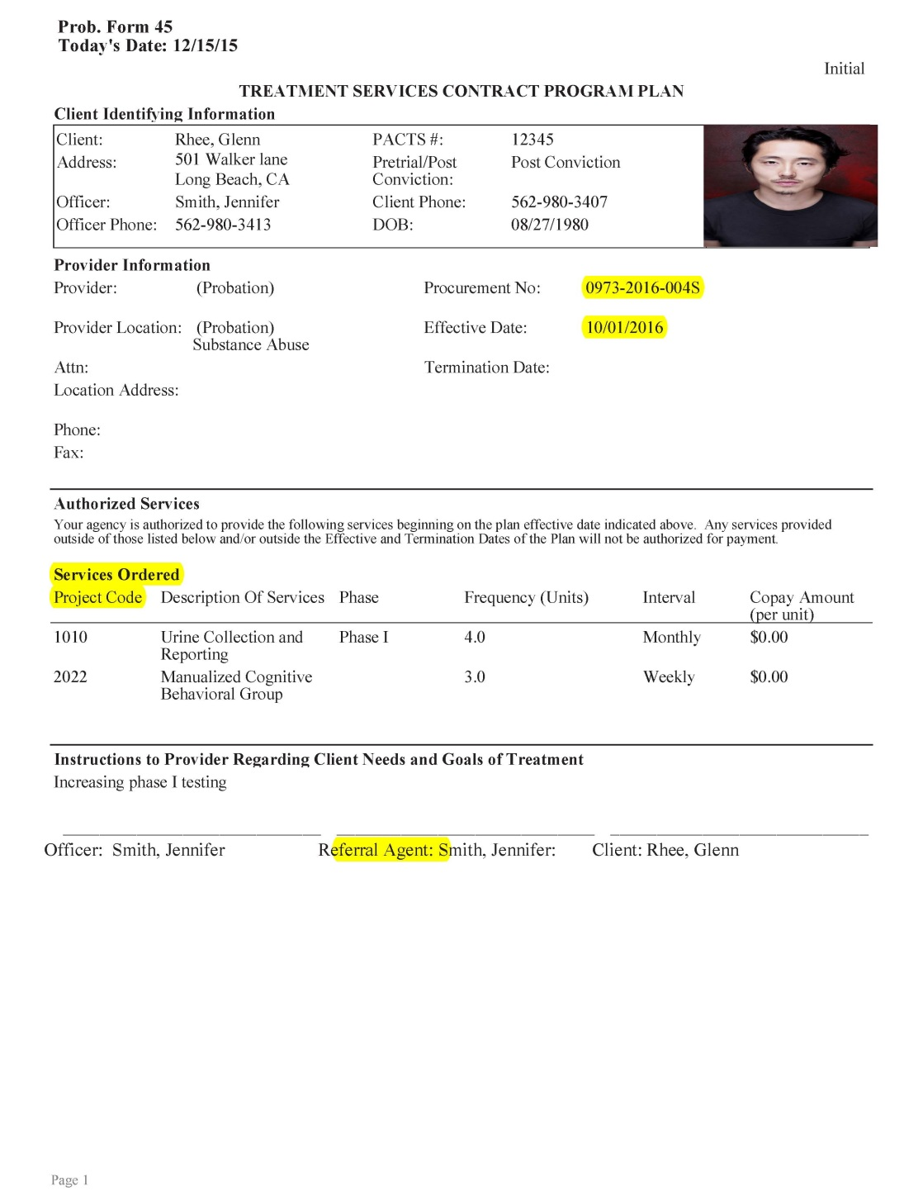
Program Plans
Review program plans to ensure all necessary codes are included
Do not provide any services not listed on the program plan
We will not pay for services and no verbal authorizations will be accepted
Maintain copies of ALL program plans in the file (initials, amended, terminations)
Notes:
Please do not provide services if you do not have a program plan.
No verbal authorizations from POs do not even ask!
Ensure defendants/offenders are rescheduled for urinalysis collection when they fail to show, to ensure they received the required services prescribed in the Program Plan.

Slide 16
Co-Payments
Defendant/Offender Reimbursement and Co-Payment (SOW)
The vendor shall:
Collect any co-payment authorized on the Program Plan (Probation Form 45) and deduct any collected co-payment from the next invoice to be submitted to the judiciary;
Provide bills and receipts for co-payments to defendants/offenders. The vendor shall keep an individualized record of co-payment collection, make it available for the USPO/USPSO review, and have systems in place to both follow-up on collection of outstanding amounts and to resolve any discrepancies in the amount owed;
Document within the Monthly Treatment Report and the Sign-In/Sign-Out Daily Log any co-payment received or whether the expected co-payment was not provided, as well as the amount of any outstanding balance;
Inform the USPO/USPSO within 10 calendar days of a defendant’s/offender’s failure to make a total of three consecutive scheduled co-payments;
Reimburse the Judiciary as directed in Section G.
Note: The vendor may charge an Administrative Fee (1501) which is a reasonable monthly fee. To administer the collection of fees from defendants/offenders, not exceeding 5% of the monthly funds collected. The vendor shall accept credit or debit card payments for co-payments.
Notes:
During the summer, we sent out an email to all of the vendors advising that our agency would place a bigger emphasis on co-payment collection.

Slide 17
Monthly Treatment Report Instructions :
Fill out completely
Including test results when applicable
Also indicate co-pays collected
NO canned language- must be individualized to each client
Include Co-payment documentation (paid/owed)
Send to Carina Forsythe and also send to Fiscal along with invoice by the 10th of every month

Slide 18
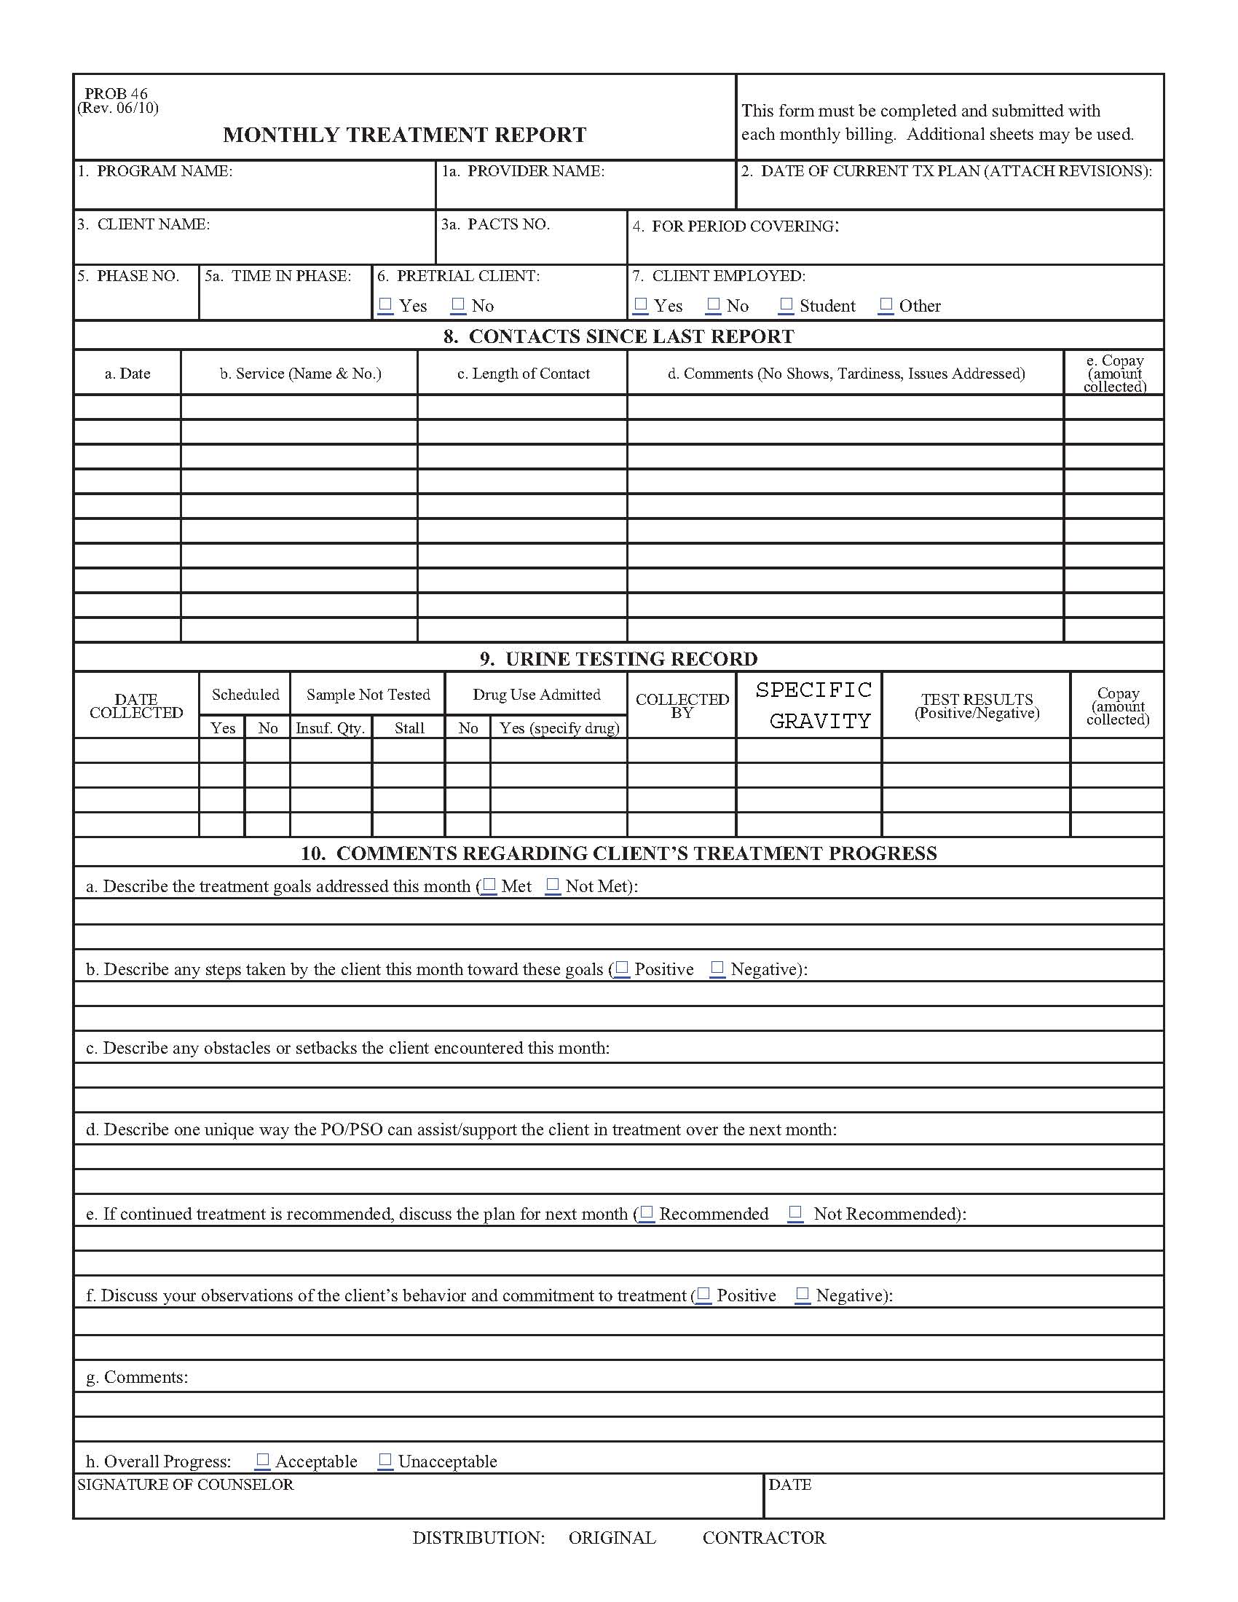

Slide 19
Residential
For Substance Use:
Submit a MTR monthly. Vendor will include a second page that summarizes the frequencies of all treatment provided in the month including groups, individual sessions, 12-Step meetings, cognitive behavioral groups, and family treatment
For Co-Occurring:
The MTR is to include information about substance use and mental health issues. A second page is required that summarizes the frequencies of all treatment provided in the month including groups, individual sessions, 12-Step meetings, cognitive behavioral groups, family treatment plus meetings with the psychiatrist, a DSM diagnosis, and a list of all psycho-tropic medications.

Slide 20
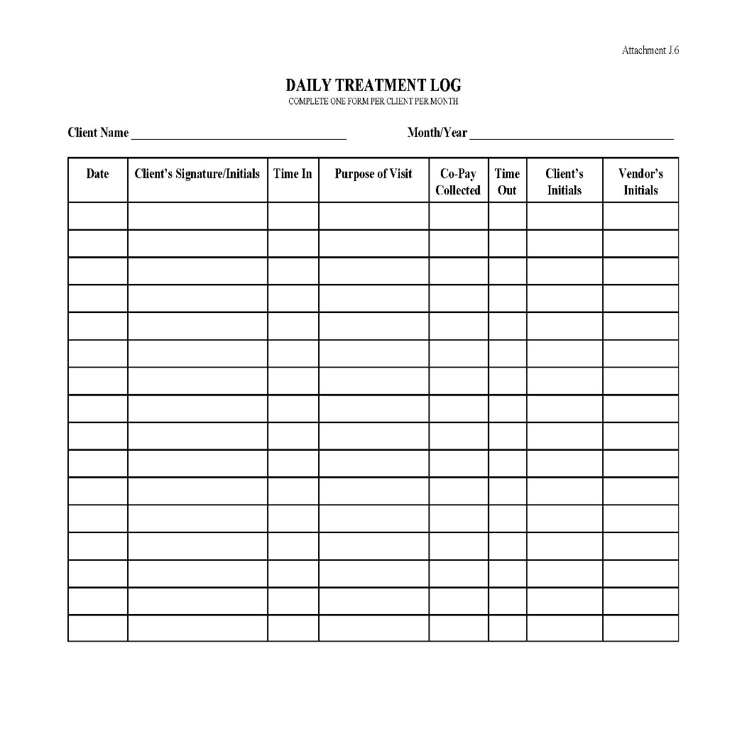
Daily Treatment Log (DTL)
D/O enters service and signs in and out for each service
Each service must be listed on a separate line (i.e. counseling and testing)
Vendor also signs each entry
TELEMEDICINE: Each session must indicate if it was done via teleconference, video conference or internet
Include DTL with invoice submission monthly
Include Co-Pay Collected
Notes:
Not necessary for residential programs
Important that vendor does not enter the information for the D/O. The D/O must enter dates, times, purpose of visit

Slide 21
Telemedicine
The AO has approved the use of telemedicine during the pandemic AND beyond
Telemedicine is to be used for the benefit of the Judiciary and the D/O, and not solely the convenience of the vendor. Vendor should have D/O sign documentation agreeing to telemedicine
Officer and vendor should discuss who would benefit from in-person treatment, and if the D/O approves, there should be an understanding that they need to follow through with the same form of treatment (to help with accountability/miscommunication/no-shows)
Notes:
As more in-person services are taking place in the community, we want to transition to a hybrid approach when it comes to treatment. (Offer in-person or telemedicine).
If D/O is being seen in-person, the D/O must stick with in-person treatment, and cannot switch to telemedicine on certain dates and vice versa.

Slide 22
Staff changes
The vendor shall notify the Treatment Services Coordinator in writing of any staff changes and provide documentation of any required licensing, certification, experience and education requirements, or changes thereof. The vendor shall submit an Offeror’s Staff Qualifications form (Section L - Attachment C) for each new staff member added under the agreement. Please indicate the new duties and if the staff will be the contact person for referrals.
Vendor shall ensure that new staff is trained in federal procedures as outlined in the SOW.
Notes:
We keep a current list for officers identifying who referrals should be sent to so if they change it is imperative you notify us so that there will be no delays in referrals
Specifically in the Statement of Work.
Check the internet for the specific SOW.
Let us know which location(s) the new staff member will be providing services/ List out each project code.

Slide 23
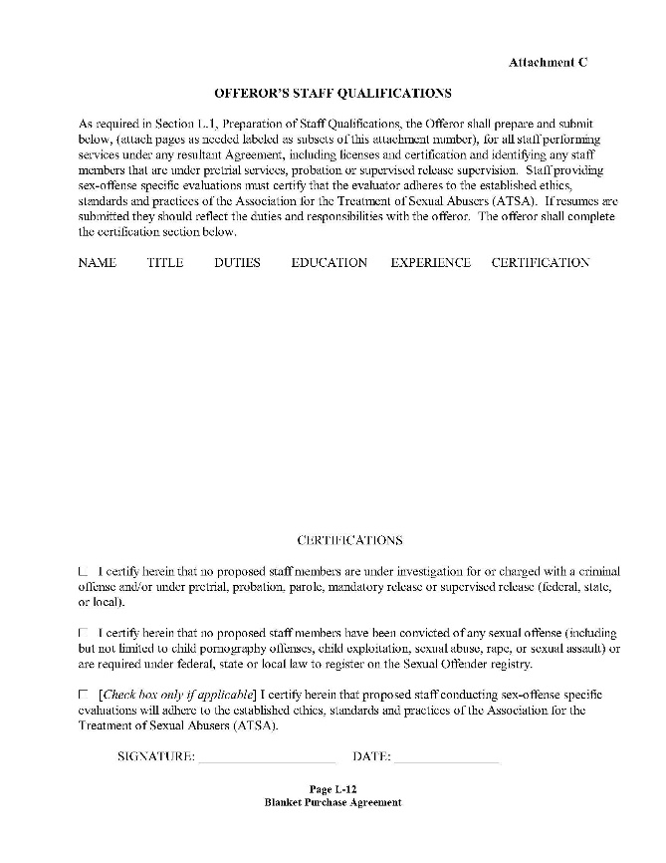
Staff Qualification Form
Notes:
Form can be found on our internet site.

Slide 24
Code-a-Phone/Testing Issues
Change message daily, even if there is no testing the following day
Do not give more than 12 hours notice (can begin new messages at 5:00pm)
Must save recorded messages for 72 hours
Message should be clear
Do not advise the D/O of the number of tests for the month
Notes:
Please change the messages at a decent time for those D/Os who work early so they don’t have to stay up late to call in
No muting, muffled recordings, enunciate, should be able to understand message.

Slide 25
Testing Reminders
Ensure you enter the correct PACTS number on each chain of custody form
Enter your program name and date of collection is on each chain of custody form
Ensure all required signatures are on the chain of custody form prior to packaging sample for mail
Ensure you apply the seal correctly in order to avoid compromising the integrity of the sample
Notes:
(SKIP IF CINDY ALREADY COVERED THIS):
I want to highlight the common mistakes because this is so important for the integrity of our drug testing programs.
When these errors occur, the integrity of our testing and your programs is jeopardized.

Slide 26
More Testing Reminders
Ensure that enough pressure is applied to the first ply (chain of custody form) so that the information transfers to the second ply (chain of custody form). Make sure you send the 2nd Ply only.
Ensure the Laboratory Chain of Custody forms are complete, including the "Medications“ section. The offender/defendant must write either:
1) the medications they are taking, or
2)"none" if they are not taking medications.
Notes:
(SKIP IF CINDY ALREADY COVERED THIS)

Slide 27
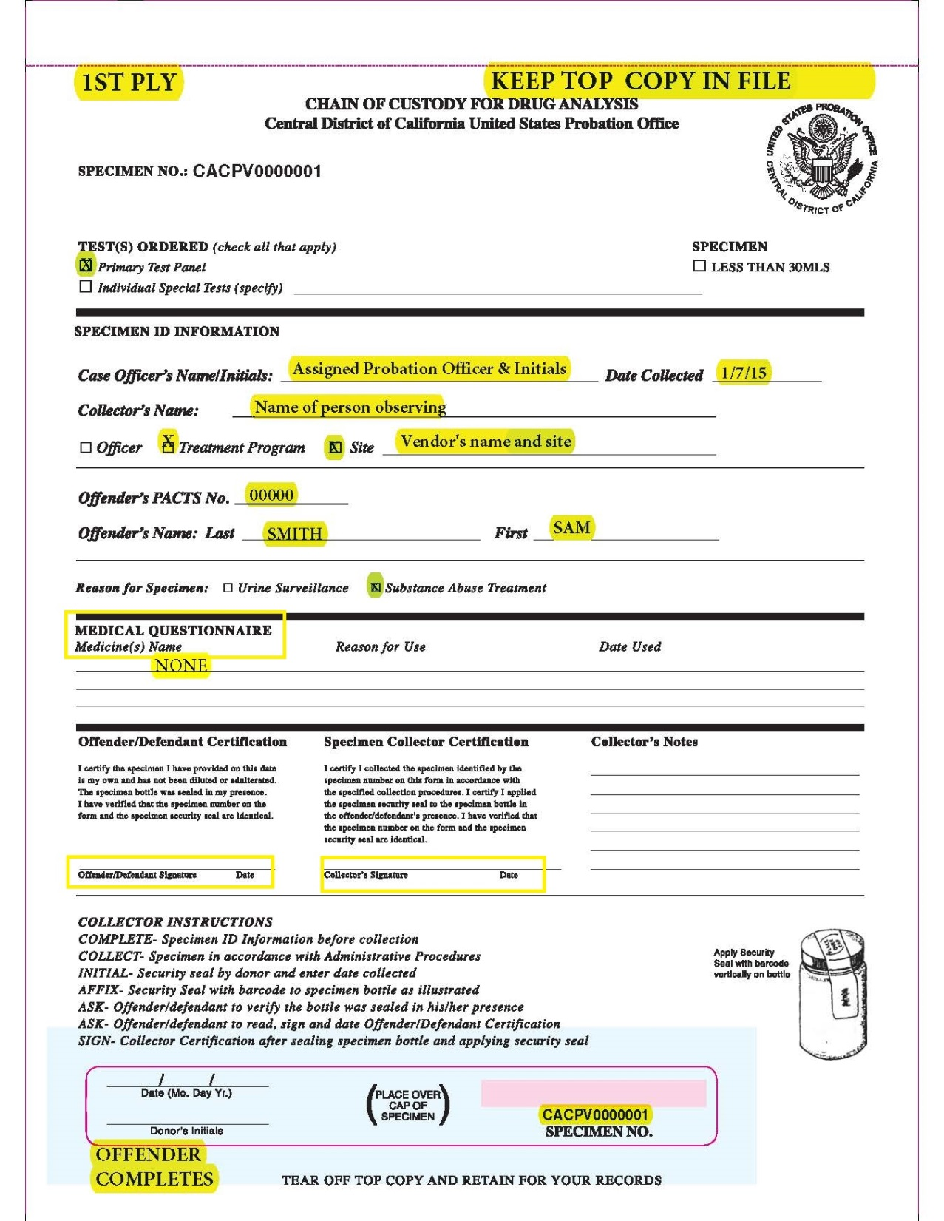
Notes:
(SKIP IF CINDY ALREADY COVERED THIS)

Slide 28
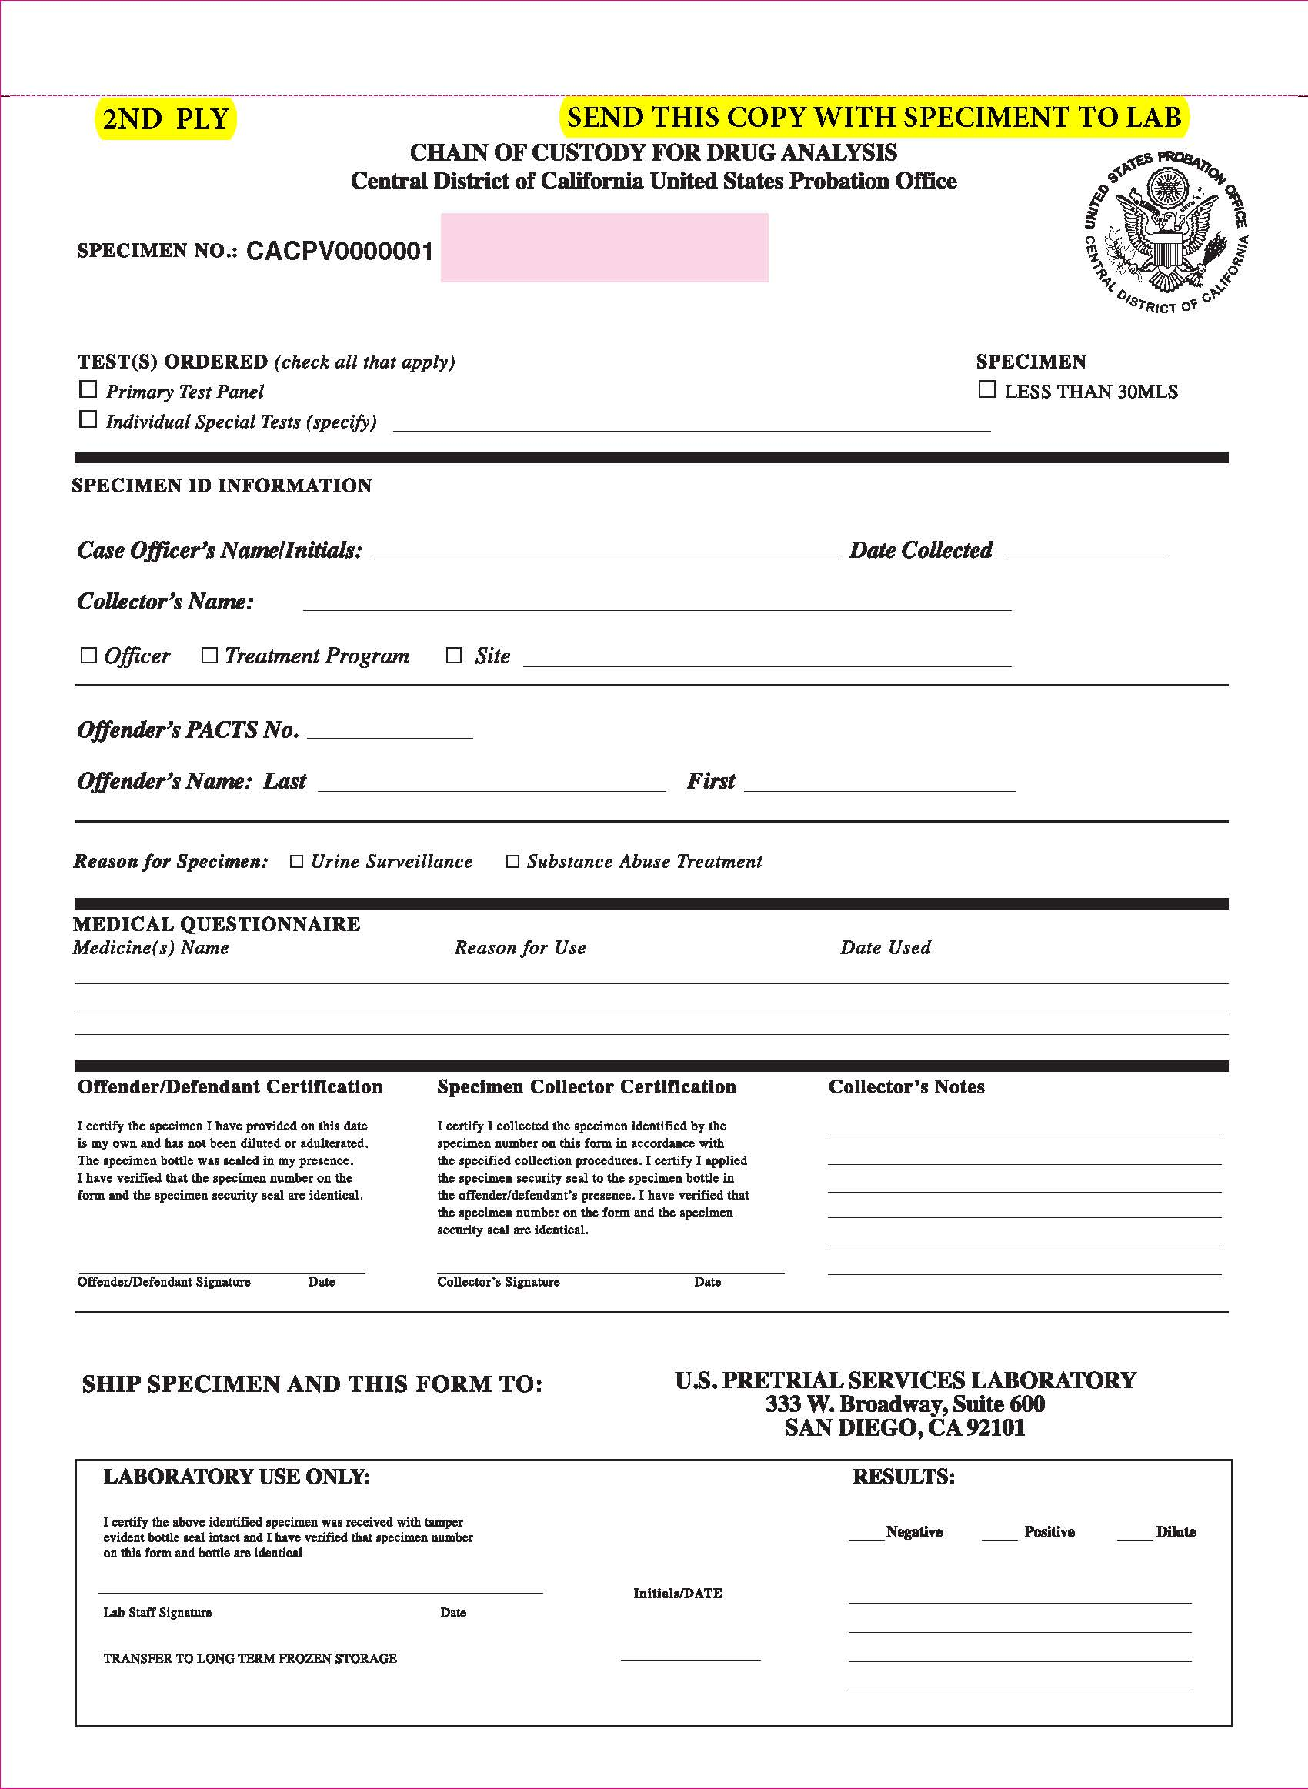
Notes:
(SKIP IF CINDY ALREADY COVERED THIS)

Slide 29
Collectors shall:
Use a clinical refractometer on all specimens
Ensure specific gravity (s.g.) is 1.003 or higher. DO NOT send an invalid specimen If s.g. is low, allow 2 hours to collect another sample.
Ensure sample is no less than 30 milliliters
Permit no more than 2 hours to provide a valid sample if stall occurs.
Collect urine between the hours of 5:00 am-9:00 am only.

Slide 30
UA Test Results
Positive test results should be discussed with the D/O’s and with the assigned Officer
Your intervention and recommendations are very important.
Notes:
With the new method of testing, sending all to lab, the interaction of the positive onsite result at the time of collection is lost. Drug use should be discussed with D/O if it is known.
Discussing results with offenders is imperative to address the relapse and for the treatment process
Talking to officer to determine course of action is also imperative, make recommendations and increase services

Slide 31
Treatment Collaboration
Common thread of this presentation was:
How to improve compliance with the SOW
The importance of the collaboration between the officers, clinicians, collectors, and defendants/offenders
Together we can make a significant change in people’s lives

Slide 32
Probation & Pretrial Services Website
http://www.cacp.uscourts.gov
Notes:
This is the link to our internet site, which contains Statements of Work for all of our BPAs, necessary forms and the slides from today will be posted as soon as possible.

Slide 33
Contact Info
RICHARD HWANG
SUPERVISOR AND TREATMENT SERVICES COORDINATOR
Richard_Hwang@cacp.uscourts.gov

Slide 34

Questions or Comments

